Slide 1
Interference Aware Inter-Cell Rank Coordination for 5G Wide Area Networks

Slide 2
OBJECTIVE
The main objective of this project is to design inter-cell rank coordination scheme to reduce inter-cell interference.

Slide 3
ABSTRACT
In general multiple receive antennas facilitate interference suppression through the use of interference rejection combining receivers. In this paper, we propose an inter-cell rank coordination scheme whereby a serving base station coordinates the preferred maximum interference rank with the dominant interfering BS.

Slide 4
PROBLEM STATMENT
In the case of dense networks with multiple receive and transmit antennas, collectively known as multiple input multiple output (MIMO) more chance of Interference.

Slide 5
EXISTING TECHNIQUES
1. By coordinating users to orthogonalize their transmissions in time or frequency
2. by increasing the transmission power
3. Inter-Cell Interference Coordination (ICIC) [2] and enhanced ICIC (eICIC) [3] in LTE systems involves coordinated scheduling among interfering base stations (BS). The aim is to control the transmit power in certain time/frequency resources in order to to reduce the generated interference.
At the receiver end, interference suppression receivers such as the interference rejection combining (IRC) receivers can be employed to actively suppress parts of the interference signal.

Slide 6
Coordinated transmitter-end interference management techniques, such as transmit precoding [4] can also be applied to dynamically control the number of interfering streams.

Slide 7
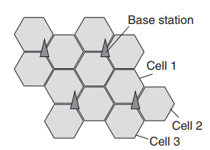
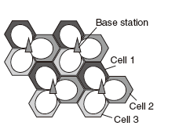
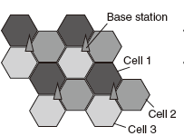
inter-cell interference
.One base station Is used for 3 cells (Sectors) as in fig a. Inter cell interference occurs due to reuse of same frequency in adjacent cells.
.This is reduced by allocating different frequencies for adjacent cells as shown in fig.b. But it reduces throughput
.Fractional frequency reuse(FFR) proposed: the same frequency bands allocated to the area near to the base station where no ICIC (same frequency =where no icic): As shown in fig c.
Notes:
<number>

Slide 8
PROPOSED ()
The generated inter-cell interference from the neighbouring dominant interferer BS is coordinated through the exchange of Xn messages.

Slide 9
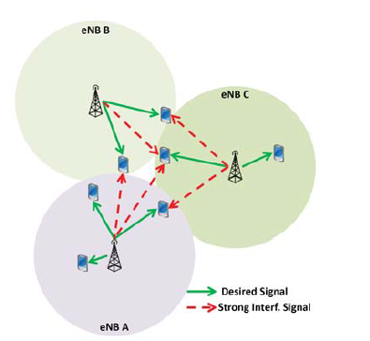
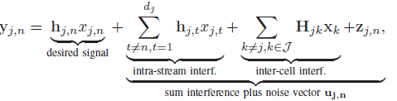
SYSTEM AND SIGNAL MODELS (fading channel)
MU-MIMO with TDD
1. users within the same cell are scheduled in orthogonal narrowband resources
N=Transmitter antennas
M=Receiver antennas
Received signal per frequency sub-carrier=

Slide 10
Contin…
H_{jk} , Xk = channel gains between the receiver of cell j and the transmitter of cell k, and the transmitted symbols at cell k respectively.
total mean interference power experience by the receiver in cell j from all transmitting streams of cell k=σ²_{jk}
Covariance matrix of the received signal at the desired receiver yj,n=
Assuming the different transmitter sources to be mutually uncorrelated, Σy can be expressed as Σu=convariance matrix=HDH^{H}
D=K−dimensional diagonalmatrix=kth diagonal element represent the mean interference power of the respective interference stream

Slide 11
5G Model Considerations
uplink (UL) and downlink (DL) have symmetric frame format.
Frame Structure=control part time separated by a data part.
The first symbol of the data part is dedicated to the Demodulation Reference Sequences (DMRS) for enabling channel estimation at the receiver, thereby facilitating the use of IRC receivers.

Slide 12

Dominant Interference Ratio
ratio of the dominant interference power over the rest of the interference power.
Υ =The interference powers at a receiver of interest from different BSs

Slide 13
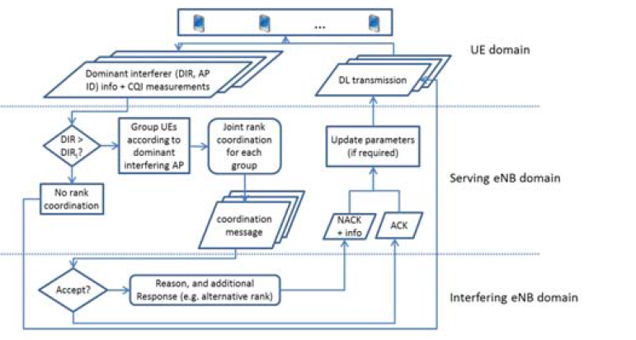
BLOCK DIAGRAM

Slide 14
EXPLENATION
The UEs report the DIR information along with channel quality indicator (CQI) message to the serving BS. Will send Relative power of the strongest interferer and its ID.
The serving BS invokes ICRC if the DIR is above a certain pre-specified threshold. A threshold value of 2 − 6 dB is found to be a good choice.
The UEs selected for ICRC are then grouped according the dominant interfering cell. In this way, the rank coordination can be more efficient, and will not result in conflicting coordination requests from the same BS.

Slide 15
priorities
ultra-reliable low latency communication (URLLC) service message is expected to be translated to a high priority.
massive machine type communication (mMTC) servicemessage will most likely be associated with a lower priority.
Transmission state information
A transmission with a higher Hybrid Automatic Repeat reQuest (HARQ) counter, i.e., messages that are being repeated, will have a higher priority than a similar message being transmitted for the first time.

Slide 16


Procedure Post-IRC SINR Estimation
interference covariance matrix (ICM) is required to estimate the post-IRC SINR.
post-IRC SINR of The desired signal=
But..
we derive post-IRC SINR as a function of the desired signal strength and the dominant interferer power
interference covariance matrix Σ=TΛT^{H} ; Λ = Diag (λ1, λ2, . . . , λM)=the eigenvalues of Σ
unitary matrix T=eigenvector corresponding to the eigenvalue λm
Final Modifeid IRC SINR=

Slide 17


can be calculated as
mean interference power
M=Receiver antennas.

